Slide 1
CSC131 Spring ‘19 Computer Software Engineering
Introduction

Slide 2
Syllabus
Class time & location
Section 2: M/W, 4:00PM - 5:15PM, SLN 2002
Section 3: Tu/Th, 5:30PM - 6:45PM, SHS (Shastha) 143
Section 5: M/W, 5:30PM – 6:45PM, Riverside 1002
Instructor
Email: jagannadha.chidella@csus.edu
Office: Riverside Hall 5004
Phone: (916) 316-8506
Tentative office hours: (subject to change)
T/TR : 6:45-7:15pm
M/W: 6:45-7:15pm

Slide 3
Syllabus (cont.)
Course Content
How to develop high-quality software systems that are delivered on time and within budget using modern development tools.
Two aspects:
Managing the effort and,
Applying effective tools and techniques.
We will survey both aspects and apply them by building a system in teams of 5-6 members during the semester.

Slide 4
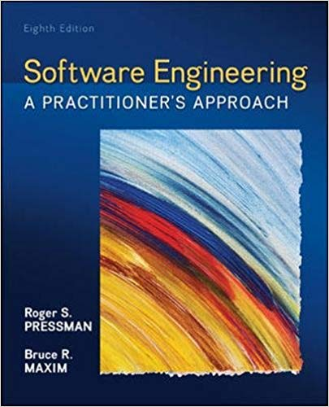
Syllabus (cont.)
Goals
Text Book
Software Engineering: A Practitioner’s Approach,
R. Pressman, 8th edition, 2014, McGraw Hill
Safari books (free through library)
Text (to be posted in Canvas)
Attendance & Participation
Lecture
Labs
In-class activities

Slide 5
Syllabus (cont.)
Grades
Criteria:
No curving
Note: Your overall grade in Canvas grade book will NOT be accurate until all grades (homework, labs, in-class activities, project, exams) are entered. However, it is a good indicator of your current performance.
Assignments | Weight
Labs + In-class Activities | 10%
Homework Assignments | 10%
Team Project | 30%
Midterm Exam | 20%
Final Exam | 30%

Slide 6
Syllabus (cont.)
Labs
Attendance is required.
Homework
Individual work unless advised otherwise
Late homework will be accepted within 2 days after due dates, with 25% penalty for each day.
Project
30% of your grade
Work as teams
Be professional
Peer evaluation

Slide 7
Syllabus (cont.)
Important Dates (see syllabus)
Midterm – Week 8
Last day to withdraw – Note online
Final – Week 16
Academic Honesty
Reference to others’ work
Questions?
Survey in Canvas

Slide 8
A Question for You
Why do you take this class?
What is this class all about?
Programming skills?
Algorithm analysis?
Team building?
…

Slide 9
The Process
Why does it matter?

Slide 10
A Card Game

Slide 11
Step 1 Preparation
Form your groups
Each group should have 5-6 members
Introduce yourself to your group mates
Shuffle your cards, and exchange with your adjacent groups
Try all means necessary to shuffle the cards. Your goal is to make it hard for the other group to sort the cards

Slide 12
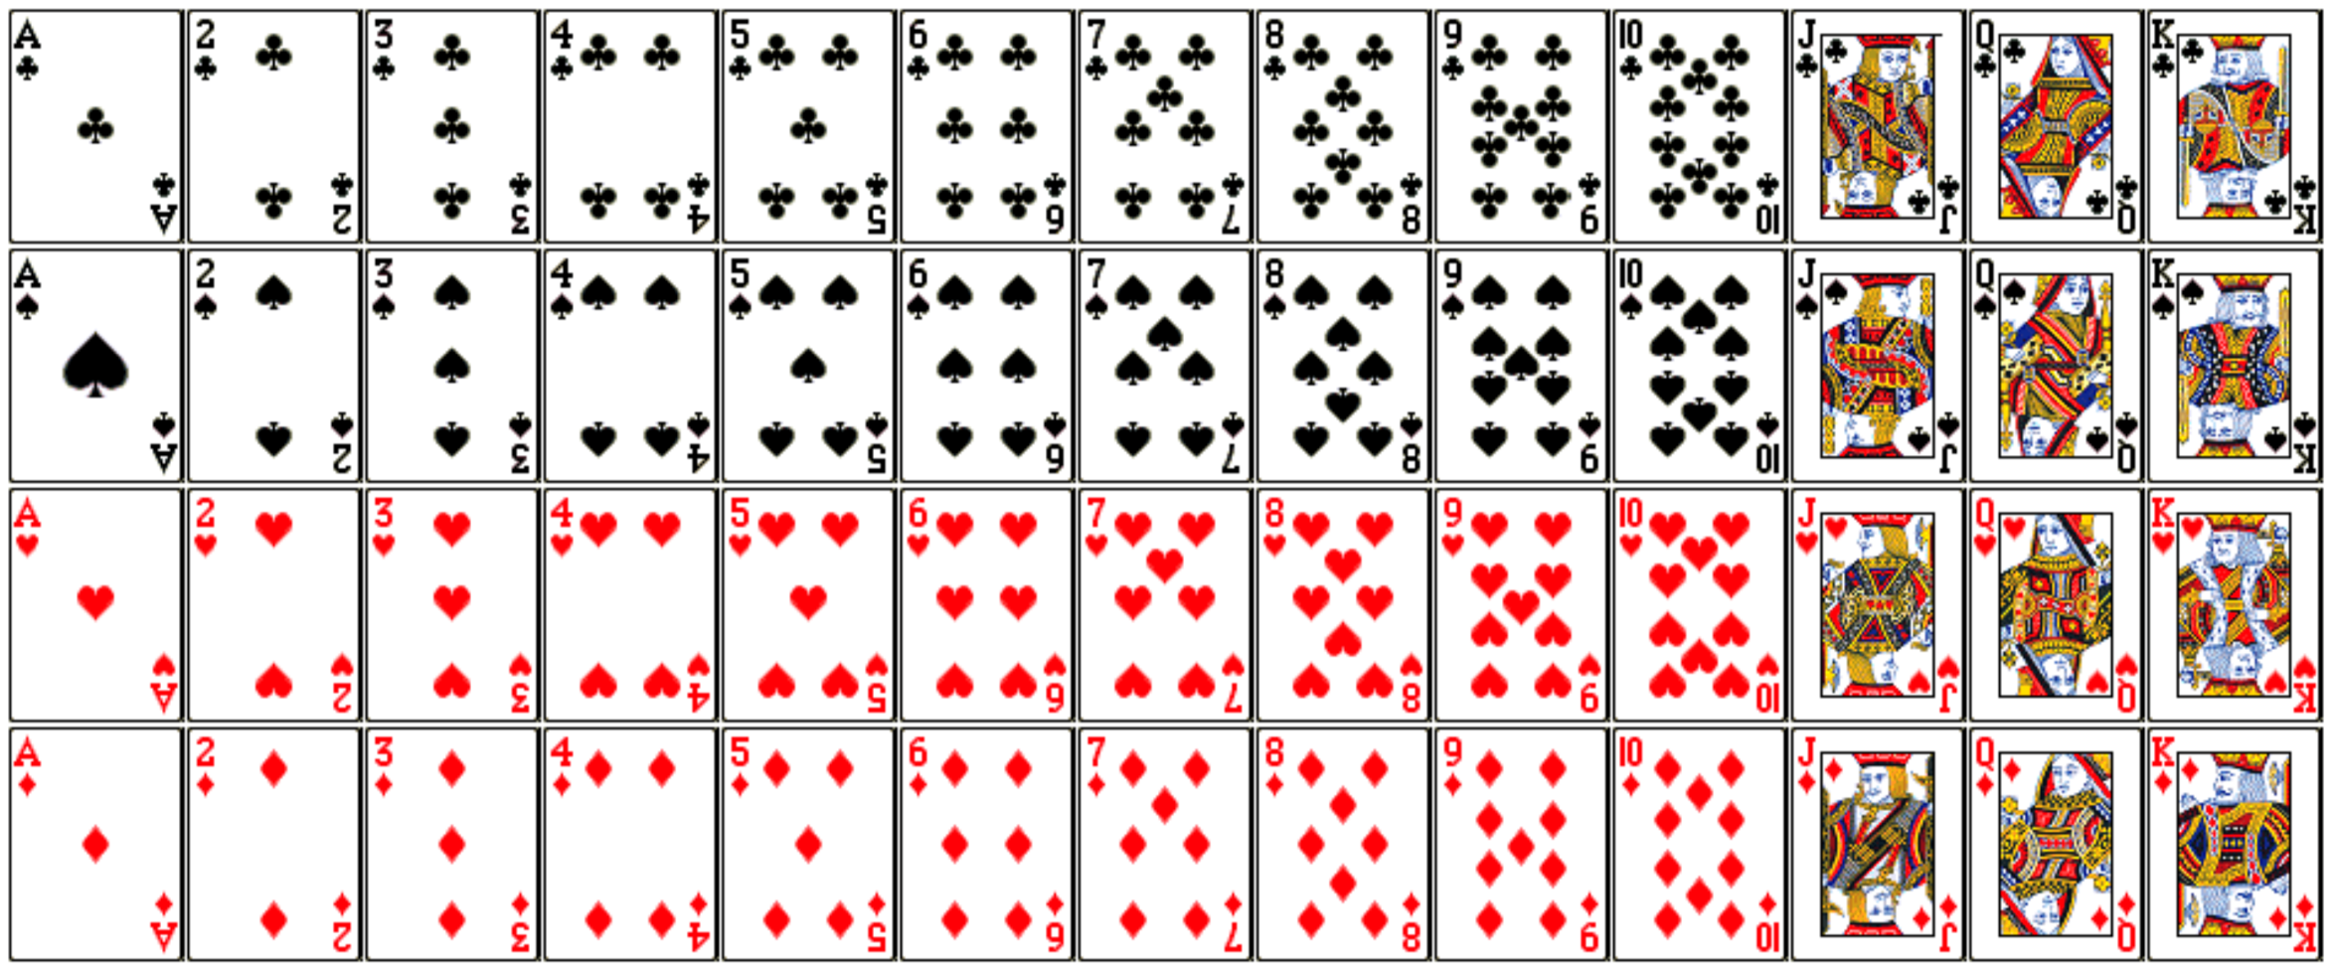
Step 2 Understanding the Rules
Goal – to sort
the cards like
this:
At any moment, only one person can touch one card with one hand only.

Slide 13







Step 3: Assigning Roles & Planning
Company Alpha Plans:
Company Beta
C
D
Player A can spread cards.
Player B can flip cards.
Player C can touch ”Club” only.
Player D can touch ”Spade” only.
Player E can touch “Heart” only.
Player G can touch “Diamond” only.
Order to touch cards: A –> B –> C –> D –> E -> G
B
E
A
G
?
?
?
?
Form your own plan.
?
?

Slide 14
Game Start! You have 2 mins to sort the cards!

Slide 15
Time is up.

Slide 16
Step 5 Reflection
Company Alpha
What went well with the plan?
What went wrong?
What can you do better as an individual?
What can you do better as a team?
Company Beta
Did you like your plan?
What would you like to change? (It is OK if you think your plan is perfect.)

Slide 17
Let’s rematch!

Slide 18
Shuffle Cards

Slide 19
Game Start! You have 2 mins to sort the cards!

Slide 20
Time is up.

Slide 21
A Follow-up Interview
Did you feel like a team?
What would happen if something happened to kill the project 75% of the way through? (Considering a full suit of same rank is a feature)
For Company Alpha, what do you like/dislike about your plan?
For Company Beta, did you change your process after Game 1 at all? How would you change things next time to be even better?

Slide 22
Factors influencing our process
Individual strength
Collaboration
Communication
Risk management
Exception handling
…

Slide 23
Before Wed Class
Complete the survey in Canvas
Reading assignment in Week01 Module
Programming assignment on CodingBat

Slide 24
1. Introduction to SE

Slide 25
What is Software?
To the Hardware:
A collection of instructions to be executed by a computer/processor
To the Developer:
A collection of human-readable statements (in a language) that can be converted to a collection of instructions to be executed by a computer/processor
To the User?

Slide 26
The Organization of Software
Program:
Any piece of software that can "run on its own" (including utilities, tools, scripts, apps, etc...)
Sub-Program:
A collection of instructions/statements that implement an algorithm for accomplishing a specific task or tasks
Library:
A group of related sub-programs for accomplishing a specific collection of (usually related) tasks

Slide 27
From Software to Software Product
What People (Other than Us) Care About:
Having everything they need to solve one or more problems or achieve one or more goals (i.e., a complete means to one or more ends)
Definition:
A software product is one or more programs, sub-programs, or libraries, along with the data and supporting materials and services, that a client can use to solve problems or achieve goals

Slide 28
Kinds of Software Products
Bespoke:
Software products that are developed (usually under contract) for a specific client
Generic:
Software products that are developed (usually speculatively) and then sold to market clients (either a mass market or a niche market)
Examples?

Slide 29
Software Engineering
Defined:
The application of (scientific) theories, methods and tools to the specification, design, creation, verification/validation, deployment, operation, and maintenance of software products
Scope:
From specification to maintenance
Involves technical and managerial concerns
Involves theories/methods from psychology, mathematics/statistics, computer science, and management (of people and resources)
Consists of science and art

Slide 30
Software Engineering vs. Computer Science/Engineering
Computer Engineering:
The application of theories (often from physics) to the creation of computational devices
Usually thought of as a subset of electrical and electronic engineering
Computer Science:
The theories and methods that underlie computation and the use of computational devices

Slide 31
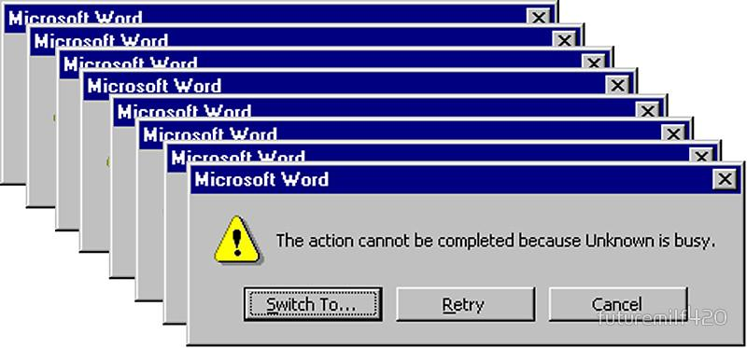
Why Software Engineering?
My experience

Slide 32
2. System

Slide 33
Motivation
Some Commonly Used Phrases:
The systems needs to...
... is a complex system...
An Interesting/Troubling Observation:
Most people can't define the word "system"

Slide 34
Systems
System
A set of entities, their attributes, and the relationships between them.
Entities
The components of the system that are known/observed.
Attributes
The properties of the entities (i.e., the external manifestations of the way the objects are known or observed).
Relationships
The bonds that link entities and attributes

Slide 35
Abstraction
A Definition:
Abstract (verb): To extract what is important
Two Observations:
An object/concept can be conceptualized in an enormous number of ways
The level of detail (which is the inverse of the level of abstraction) is a defining feature of the system
Example: A Car
Low Detail - A source of emissions
Medium Detail - A contributor to traffic congestion at an intersection
High Detail - A mechanical motive device

Slide 36
Systems (cont.)
We gauge the level of detail/abstraction by viewing the system under consideration in relation to:
Example: A Car
Low Detail - A source of emissions
Medium Detail - A contributor to traffic congestion at an intersection
High Detail - A mechanical motive device
Environment | The set of all other systems (also known as the context and the domain)
Subsystems | Parts of the whole which display a richness of interrelationships
Elements/Atoms | The smallest parts of the system (i.e., the black boxes)

Slide 37
Physical and Conceptual Systems
Physical Systems:
Can be "pointed to"
Include entities that exist in space and time
Conceptual Systems:
All other systems

Slide 38
System State
Defined:
An unvarying (over space, and/or time, and/or some other dimension) description or summary of that system
Specification:
All of the attributes (at an appropriate level of abstraction) of the entities that comprise the system

Slide 39
3. Modeling

Slide 40
A Definition
A mini-activity:
A model is a description of a system (that is created to help understand the system)

Slide 41
Modeling Methods
Physical Models:
Paper, clay, plastic, wood, metal, etc...
Conceptual Models:
Mathematical, computational/numerical, diagrammatic/visual/graphical, textual, etc...

Slide 42
Model Types
Static:
Models of the aspects of the system that do not change (sometimes called structural)
Dynamic:
Models of how the system changes over time (sometimes called behavioral)

Slide 43
Importance of Modeling
Some Observations:
Complex systems are hard to understand
Models can be used to make them easier to understand
An Example:
You can probably build a doghouse without a model
A house would be very difficult to build without a model
A skyscraper would be impossible to build without a model

Slide 44
Modeling and Software
A Common Problem:
Start with a doghouse
Keep adding on until you have a skyscraper
What Models Provide:
An understanding of a system (as it is or should be)
A specification of a system
A template for construction
A record of the decisions that were made

Slide 45
Abstraction Revisited
The same object/concept can be conceptualized at different levels of abstraction
A system that is conceptualized at a particular level of abstraction can be modeled at different levels of abstraction
Examples?

Slide 46
Abstraction Revisited: An Example
Viewing a Car as a System:
Low Detail - A source of emissions
Medium Detail - A contributor to traffic congestion at an intersection
High Detail - A mechanical motive device
Modeling a Car as a Source of Emissions
Low Detail - Relate the number of cars to total emissions
Medium Detail - Consider the number of miles and driven and the average drive cycle (e.g., EPA estimates)
High Detail - Consider car following behavior and engine performance

